Slide 1

…… where ‘Machine Learning’ reduces customer credit risks
Lending Genie
Date 12/15/2022
FinTech Blended Boot Camp, Columbia Engineering (2022-23)

Slide 2
Executive Summary
Lending Genie is a revolutionary platform that uses Machine Learning technology to improve Credit Risk Modeling, with higher accuracy level efficiently for Financial Institutions

Slide 3
Motivation For Development
Solving the real-world business problem of Financial Institutions or any entity that wishes to increase its lending footprint
Use techniques of machine learning and power of cloud computing to prepare modern age way of finding out credit risk

Slide 4
Approach: Breakdown Of Tasks
User (FI or any counterparty that’s interested in lending to its customers) provides customer data to our application
Application cleans/prepares data for further analysis.
Application prepares 5 to 6 models and then evaluate these models to figure out appropriate model that fits the data
Application deploys the model on SageMaker for further prediction and analysis

Slide 5
Data Base Description
Data Source
Kaggle - Lending Club Loan public dataset
https://www.kaggle.com/datasets/wordsforthewise/lending-club
Rationale
Highest quality free data (2+ million records) with 150 features available
No need to have API keys or user permissions to access the dataset
*** Given massive size of dataset, we uploaded the dataset in csv format to S3 bucket:
s3://sagemaker-us-east-1-831850195362/archive/accepted_2007_to_2018q4.sv/accepted_2007_to_2018Q4.csv

Slide 6
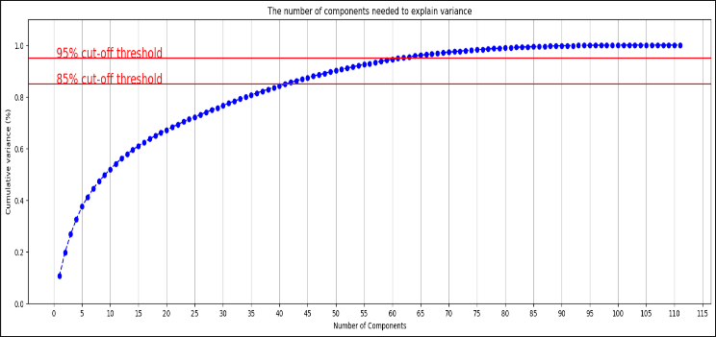
Data Cleaning & Preprocessing
Data Cleaning & Preprocessing Techniques
Read data into processing environment in chunks
Clean and preprocess data
Scale data set using Scikit Learn Standard Scaler
Systematically encode categorical values
Split data set into training and test sets
Apply Principal Component Analysis technique for dimension reduction of features set

Slide 7
Credit Risk Modeling Using Machine Learning
Following are various models that were analyzed:
Logistic Regression model
SVC Classifier model
LinearSVC Classifier model
RandomUnderSampler + LinearSVC Classifier model
K-Neighbors Classifier model
AdaBoost Classifier model
XGB Classifier model

Slide 8
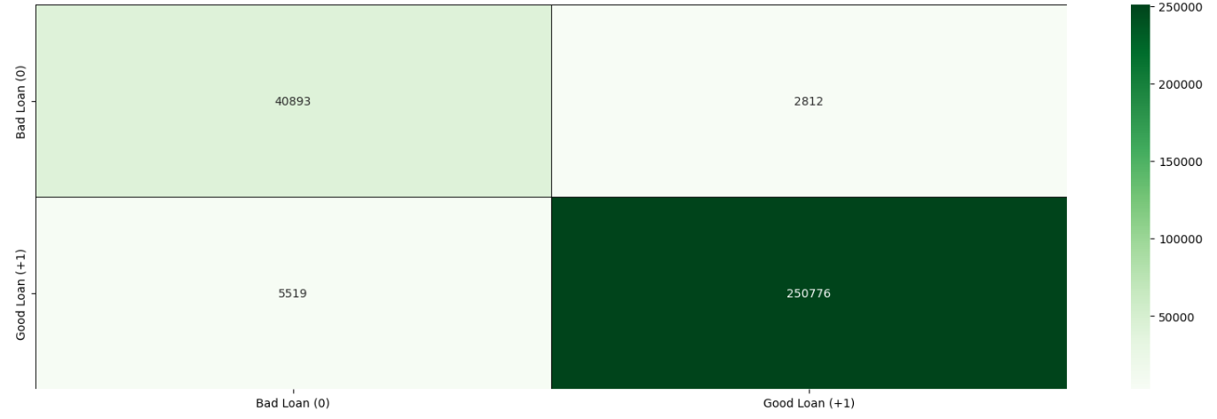
Credit Risk Modeling Using Machine Learning
Selected Model
Based on evaluation metrics, LinearSVC Classifier with RandomUnderSampler was best performing

Slide 9
Cloud Deployment: Modelling In AWS
The nearest equivalent of ‘LinearSVC Classifier with RandomUnderSampler ‘ model in SageMaker was ‘Linear Learner SVC model with balanced class weights.
Model was implemented in SageMaker and deployed for further usage.
Output evaluation parameters were:
Accuracy: 0.93
Class 1 : Loan Acceptance (good loans):
Recall : 0.92
Precision: 0.99
Class 2: Loan rejection (bad loans):
Recall : 0.96
Precision: 0.68

Slide 10



Next Steps
Additional questions that surfaced
Additional topics to research
Plan for future development
Is it possible to create an additional layer that allows data to be input from any source?
Is there a more accurate model than the Linear SV Model
GPU/CPU efficiency of models
Grid searches to find the optimal hyperparameters for development
Provide predictions to clients based on fresh data delivered periodically
Create a front end and client portal for data upload

Slide 11
Links
GitHub Repo
Ref URL: https://github.com/prpercy/LendingGenie
Learning Resource
Online: https://www.datatechnotes.com/2020/07/classification-example-with-linearsvm-in-python.html

Slide 12

Thank You

Slide 13
APPENDIX
Lending Genie
Date 12/15/2022

Slide 14
Data-mining for features
Removed null and duplicated rows. Since we have lot of data points and null and duplicated rows were immaterial, we decided not to replace them
Dropped 39 columns (reducing features to 111), because:
they did not provide any explanatory power (e.g., columns such as id, member id, settlement date, title, emp_title etc.)
Some of them were co-linear.
We devised our own encoding for categorical variables. After that app uses StandardScaler to scale features.
PCA (principal component analysis was performed) to further reduce dimensions (i.e. reduce number of features to enhance modelling capabilities).
Overall, application was able to reduce features to 62

Slide 15
Loan accepted or rejected status
Loan is accepted if the company approves the loan. There are 3 primary possible scenarios described below:
Fully paid: Applicant has fully paid the loan (the principal and the interest rate)
Current: Applicant is in the process of paying the instalments, i.e., the tenure of the loan is not yet completed. These candidates are not labelled as 'defaulted'.
Grace period
Late (16-30)
Late (31-120)
Default
Charged-off: Applicant has not paid the instalments in due time for a long period of time, i.e., he/she has defaulted on the loan

Slide 16
Challenges and work arounds
Reading huge CSV into pandas DataFrame: added parameter low_memory=false and read data in chunck sizes
Large number of Categorical variables: formulated our own encoding methodology
SageMaker model prediction was giving large size error: Split the test feature and prediction label data into chuncks and calculated evaluation parameters manually
AWS costs: Performed major modelling part outside of AWS and only deployed selected model.

